Slide 1

Database Project – (10127)
Presenters -
Yahav Yehoshua Bariah (326295417)
Itay Yehoda Benderski (326621927)

Slide 2
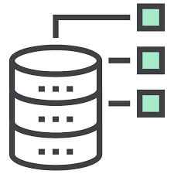
description
General description
The project focused on Object Oriented Programming (10118) in Java. It involves creating a system for generating multiple-choice and open-ended exams. The system should support adding, updating, and deleting repositories and their questions and answers, as well as generating exams either manually or automatically.
The database in the system is essential for storing and managing repositories, questions, and answers, as well as for generating exams. It organizes the data, enforces rules such as ensuring the validity and uniqueness of questions within exams, and supports operations like adding, updating, and deleting content. The database can be easily manipulated by the program and also tracks the details of each exam, including the selected questions and correct answers, ensuring the integrity and functionality of the system.
Users -
Students: Take exams.
Instructors: Manage content and review performance.
Administrators: Oversee system and data integrity.

Slide 3
Description of the entities and the relationships
Repository -
Description: Stores different professions, serving as a category for questions and answers.
Relationships: One repository can have many questions and answers, and also create exams.
Answer -
Description: Stores possible answers to questions.
Relationships: Belongs to one repository and can be associated with many questions.
Question -
Description: Stores questions that can be either open or close-ended, each having a difficulty level.
Relationships: Belongs to one repository , can be linked to either an open or close-ended question, and can be in many exams.

Slide 4
Description of the entities and the relationships
Open_Question -
Description: Represents open-ended questions, optionally linked to an answer.
Relationships: Linked to one question and can reference one answer.
Close_Question -
Description: Represents close-ended questions.
Relationships: Linked to one question and can have many answers.
Close_Question_with_answer -
Description: Links close-ended questions with their possible answers, marking the correct answers.
Relationships: Links one close-ended question with answers (True or False).

Slide 5
Description of the entities and the relationships
Exam -
Description: Stores exams that can be generated manually or automatically.
Relationships: Belongs to one repository and can contains many questions (that contains answers).
Question_Of_Exam -
Description: Associates questions with specific exams.
Relationships: Links one exam with many questions (that contains answers).
Question_Of_Automatic_Exam -
Description: Associates random questions and answers with specific exams.
Relationships: Links one exam with many random questions and their random answers.

Slide 6
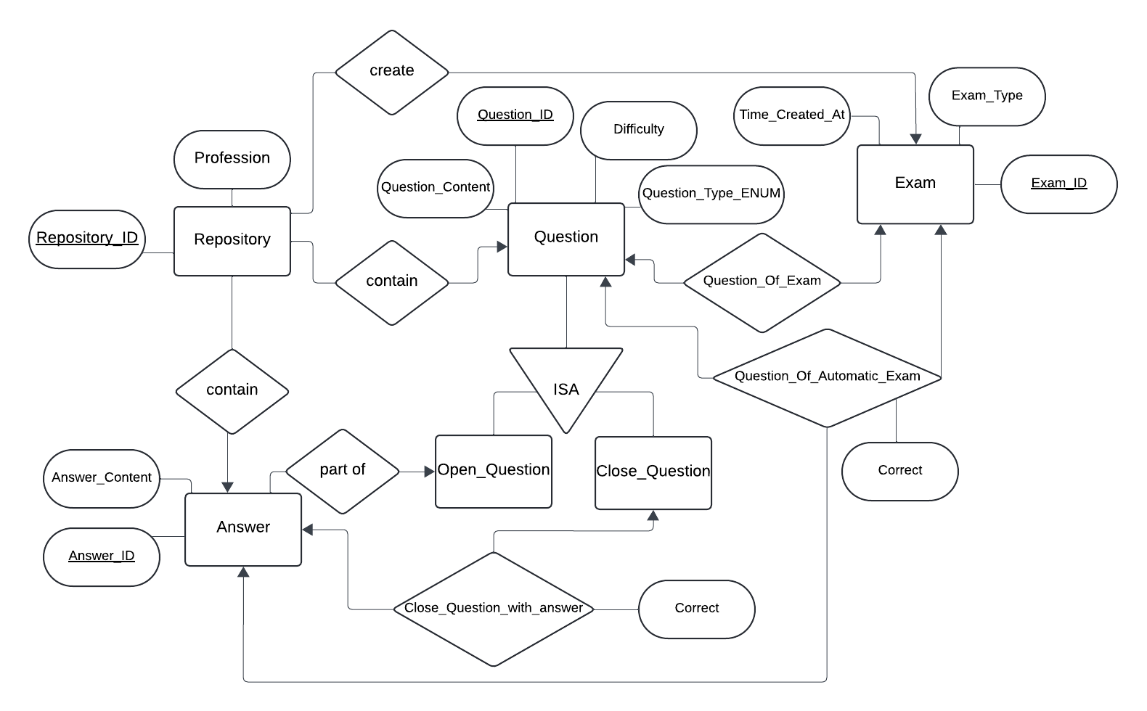
ERD

Slide 7

Tables
Repository: (Repository_ID, Profession)
Answer: (Answer_ID, Answer_Content, Repository_ID*)
* References Repository
Question: (Question_ID, Question_Content, Difficulty, Question_Type, Repository_ID*)
References Repository
Open_Question: (Question_ID*, Answer_ID**)
* References Question
** References Answer
Close_Question: (Question_ID*)
* References Question

Slide 8

Tables
Close_Question_with_answer: (Question_ID*, Answer_ID**, Correct)
* References Question
** References Answer
Exam: (Exam_ID, Time_Created_At, Exam_Type, Repository_ID*)
* References Repository
Question_Of_Exam: (Exam _ID*, Question_ID**)
* References Repository
Question_Of_Automatic_Exam (Exam _ID*, Question_ID**, Answer_ID***, Correct)
* References Repository

